Slide 1
Matlab程式設計_5_11
助教:金郁善

Slide 2
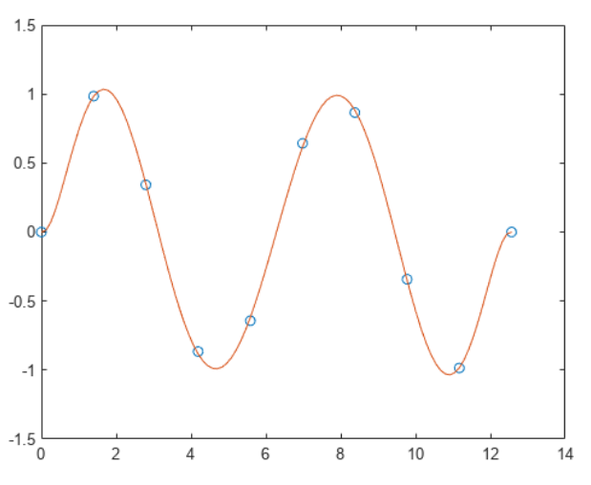
polyfit(x,y,n)
polyval(polyfit(x,y,n),x1)
plot(x,y, ‘o’)
hold on
plot(x1,y1)
hold off

Slide 3
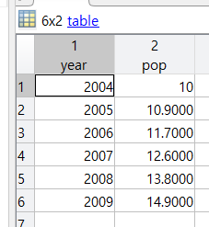
table (v1, v2)
year = (2004:1:2009)';
pop= [10 10.9 11.7 12.6 13.8 14.9]';
T= table(year,pop)

Slide 4
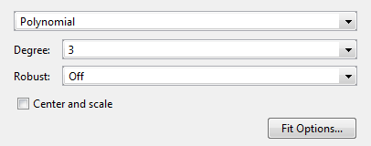
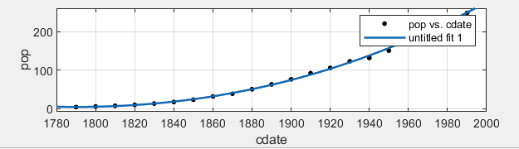
Curve fitting APP Fit a curve
load census
cftool

Slide 5
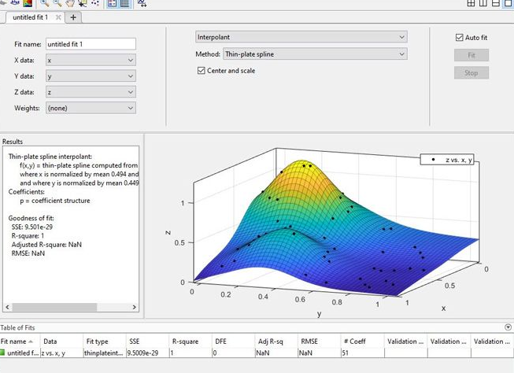
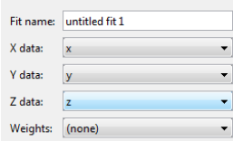
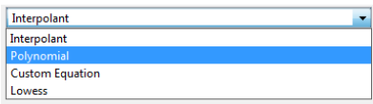
Curve fitting APP Fit a surface
load franke
cftool

Slide 6
HOMEWORK

Slide 7
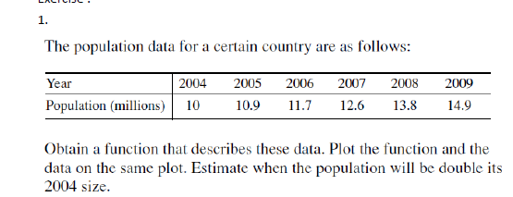

Slide 10
